Slide 1


01
COMMENT TOXICITY MODEL
PRESENTED BY : SHIVANI PANICKER - 35 , ZAID SIDDIQUE - 52, VANSH LAKHWANI - 57

Slide 2

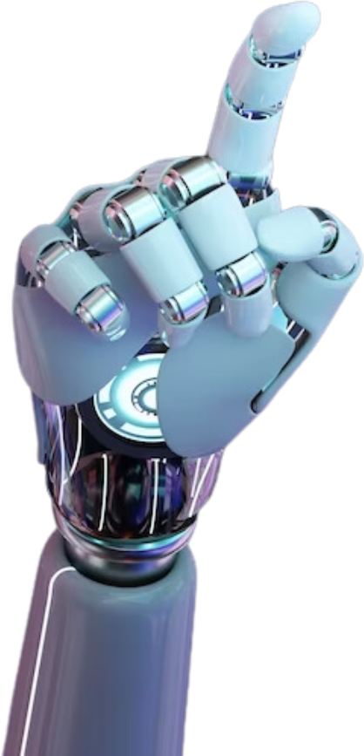
Introduction
02
The internet has revolutionized communication, but it also faces a growing problem of toxic online behavior.
Harmful comments disrupt digital spaces, affecting individuals and communities. Due to the massive volume of online content, manual moderation is impractical.
This project explores the use of deep learning and Natural Language Processing (NLP) to develop an automated system for detecting toxic comments, aiming to create safer and more inclusive online environments.

Slide 3
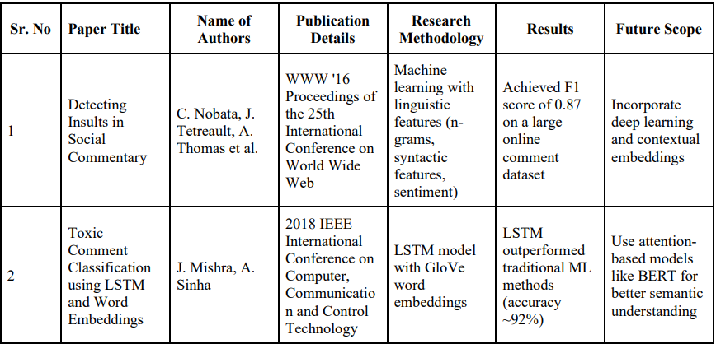
Literature Review
03
Traditional ML models with linguistic features (e.g., n-grams, sentiment) can effectively detect toxicity but lack deep contextual understanding.
LSTM-based models combined with word embeddings (like GloVe) significantly improve accuracy by capturing the sequence and meaning of words.

Slide 4
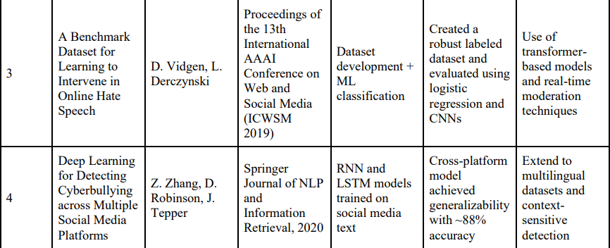
Literature Review
04
A robust, labeled dataset is crucial for training effective hate speech detection models, with future focus on transformer-based models and real-time moderation.
RNN and LSTM models are effective for detecting cyberbullying across multiple platforms, with opportunities for improving multilingual and context-aware detection.

Slide 5
Project Architecture
05
SOFTWARE REQUIREMENTS:
Operating System: Windows, macOS, or Linux
Programming Language: Python (version 3.6 or higher)
Libraries:
TensorFlow or Keras (for deep learning model)
Pandas (for data manipulation)
NumPy (for numerical computations)
Scikit-learn (for evaluation metrics and preprocessing)
Gradio (for the user interface)

Slide 6
Project Architecture
06
HARDWARE REQUIREMENTS
Processor: Multi-core CPU recommended
RAM: At least 8 GB
GPU: Optional, but an NVIDIA GPU with CUDA support is recommended for faster training.
Database Requirements
CSV files for input data:
sample_submission.csv
test.csv
test_labels.csv
train.csv

Slide 7
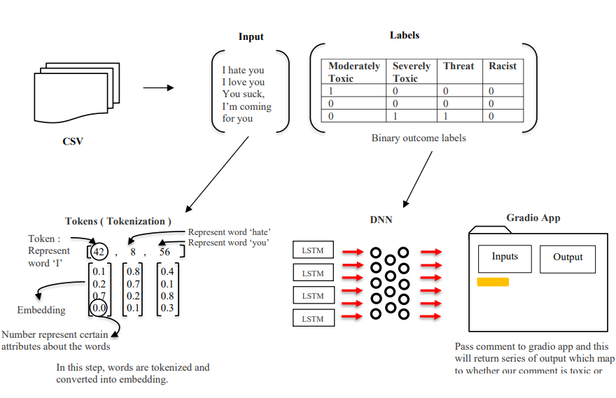
Project Architecture
07
SYSTEM DESIGN
The diagram shows a system that detects toxic comments. Text from a CSV file is tokenized, turned into word embeddings, and passed through an LSTM neural network to predict toxicity labels like "Toxic" or "Threat." A Gradio app lets users input comments and see if they are flagged as toxic.

Slide 8

Implementation
08
LOADING THE DATA:
We use Pandas to read the train.csv file, which contains comments and their toxicity labels. We also check how many comments belong to each label like toxic, threat, or insult.
PREPROCESSING COMMENTS:
We clean the text by making all letters lowercase and removing punctuation and special symbols. Then we use Keras TextVectorization to turn words into numbers, so the model can understand them.
BUILDING THE MODEL:
We create a deep learning model using Keras.
First, we use an Embedding layer to turn word numbers into word vectors. Then we add LSTM.
Finally, we add an output layer with six units (one for each label) that gives a score from 0 to 1 showing how likely the comment is to be toxic in each way.

Slide 9
Implementation
09
EVALUATING MODEL PERFORMANCE:
First, split the data into training, validation, and test sets.
Then, compile the model using an optimizer like Adam and a binary cross-entropy loss (since it's a multi-label problem).
Train the model on the training set and monitor performance on the validation set, using early stopping if needed to prevent overfitting.
After training, evaluate how well the model performs on the test set using metrics like precision, recall, AUC-ROC.
CREATING A GRADIO APP:
Save the trained model (and the TextVectorization layer or its config) in .h5 format.
Then, make a Python script using Gradio. In this script, load the model and vectorizer, define a function to preprocess new comments, pass them through the model, and return the predicted toxicity scores.
Finally, build a Gradio interface with a text input and multi-label outputs, and launch the app so users can test comments interactively.

Slide 10
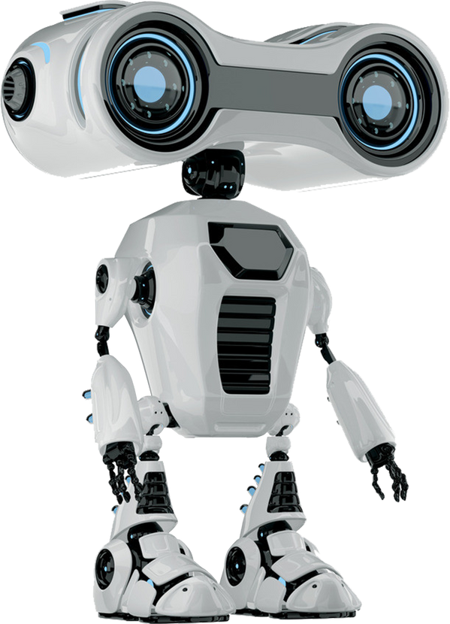
Conclusion
10
This project developed a deep learning-based multi-label classification model to detect toxic language in user comments.
Using an LSTM architecture with text vectorization, the model performed well on common labels such as toxic, obscene, and insult, while showing moderate performance on less frequent categories like threat and identity hate. Evaluation using metrics like AUC-ROC confirmed its effectiveness.
The model was deployed using Gradio, enabling real-time interaction through a simple interface. While effective in identifying explicit toxicity, future improvements such as using transformer models and addressing class imbalance could enhance performance on subtler forms of toxic content

Slide 11
Future Scope
11
CONTEXTUAL AWARENESS
Enhancing the model to consider surrounding text or conversation history can help detect subtle, sarcastic, or indirect toxic language that may be missed when analyzing comments in isolation.
MULTILINGUAL DEPLOYMENT
Supporting multiple languages by using multilingual models like XLM-RoBERTa would extend the system's usability across global platforms and help moderate diverse online communities.
DEPLOYMENT ENHANCEMENTS
Improving deployment with faster inference, API integration, and user-friendly interfaces can boost real-time performance and make the model more practical for large-scale content moderation systems.

Slide 12
Thank You!

